Slide 1










SMART HEALTHCARE ANALYTICS DASHBOARD
Course:Data Visualization& BusinessIntelligencewithPowerBI Program: BCA – Silver Oak University
Student Name: Prancey Maurya
Enrollment number : 2304030101346
Project: Dynamic Healthcare Data Dashboard using Power BI

Slide 2






Problem Statement
Healthcare organizations generate a huge amount of patient and hospital data every day..
However:
Objective of the project
Raw healthcare data is difficult to analyze manually. Hospitals need insights about patients, billing, and medical conditions. Decision making becomes slow without proper visualization tools.
To build an interactive Power BI dashboard that helps analyze:
Patient statistics Medical conditions Hospital billing Insurance data Healthcare trends
This dashboard helps hospital management make better data-driven decisions.

Slide 3


Data Source
The datasetusedisaHealthcareDataset(CSV format).
The dataset includes the following fields:
Patient Information
Hospital Information
01
Name Age Gender Blood Type
02
Hospital Doctor Room Number
Medical Information
Financial Information
04
Billing Amount Insurance Provider
03
Medical Condition Medication Test Results
Data cleaning and transformation were performed using Power BI Power Query Editor.

Slide 4

Data Preparation
(What I Did)
Before building the dashboard, the dataset was prepared.
Steps performed:
• Removed unnecessary columns • Corrected data types • Converted dates properly • Handled missing values • Created calculated columns • Created DAX measures for KPIs
This ensured the dataset is clean, structured, and ready for visualization.

Slide 5



Calculated Columns Used
Some calculated columns were created to improve analysis.
Examples:
Length of Stay
Length of Stay = DATEDIFF('healthcare_dataset'[Date of Admission], 'healthcare_dataset'[Discharge Date], DAY)
Billing Category
Billing Category = IF('healthcare_dataset'[Billing Amount] > 30000, "High Cost","Normal Cost")
These columns help analyze:
Patient stay duration
Treatment cost categorie

Slide 6





DAX Measures Created
Several measureswerecreatedforKPIsandanalysis.
1. 2.
3.
4.
5.
Total Patients
Total Patients = COUNT('healthcare_dataset'[Name])
Total Charges
Total Charges = SUM('healthcare_dataset'[Billing Amount])
Average Age
Average Age = AVERAGE('healthcare_dataset'[Age])
Average Stay
Avg Stay = AVERAGE('healthcare_dataset'[Length of Stay])
Male Patients
Male Patients = CALCULATE(COUNT('healthcare_dataset'[Name]), 'healthcare_dataset'[Gender] = "Male")

Slide 7





Dashboard Overview
The project includes 3 dashboard pages:
01
02
03
Smart Healthcare Analytics
Medical Insights
Financial Analytics
Shows overall hospital statistics:
Focuses on medical analysis:
Focuses on hospital financial performance:
Blood type vs condition Average stay by condition Condition distribution Cost category by condition
Total Patients Total Charges Average Age Average Stay Patient distribution by gender Medical condition vs billing
Charges by insurance provider Charges by hospital Doctor billing analysis Stay vs billing relationship

Slide 8

Dashboard Features
The dashboard includes several interactive features.
Interactive Filters (Slicers):
✔
KPI Cards
Hospital Gender Blood Type Insurance Provider Medical Condition Doctor
✔
Bar Charts Line Charts Pie & Donut Charts Tables Scatter Plots
✔
✔
✔
✔
These allow users to filter and analyze the data dynamically.

Slide 9
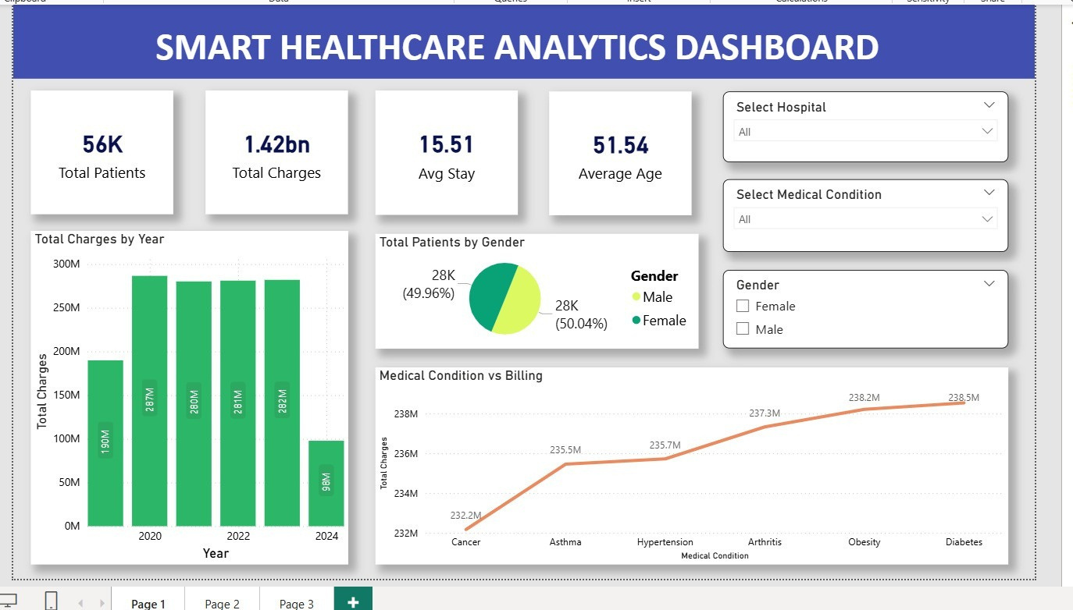

Slide 10


Smart Healthcare Analytics
This page shows overall healthcare performance.
Main KPIs:
56K Total Patients 1.42 Billion Total Charges 15.5 Average Stay 51 Average Age
Visualizations include:
Total charges by year Patient distribution by gender Medical condition vs billing
This provides a quick overview of hospital operations.

Slide 11
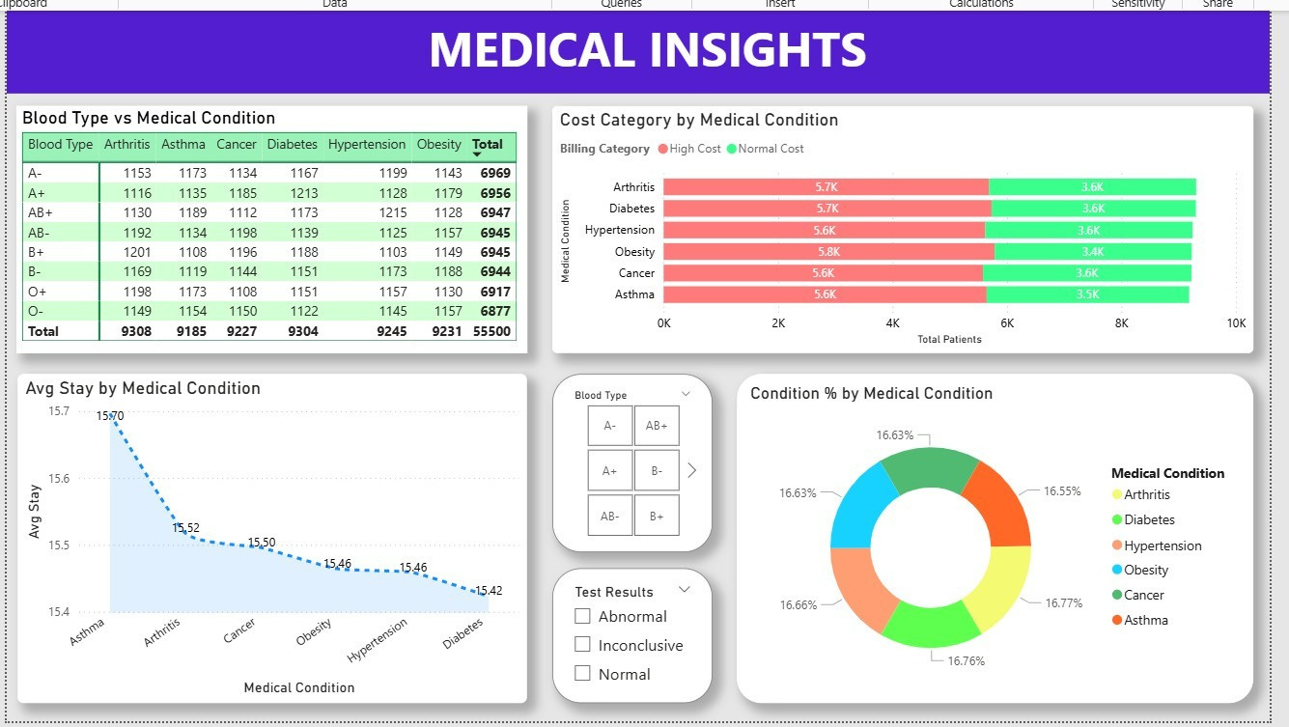

Slide 12



















Medical Insights
This page focuses on medical condition analysis.
Key visualizations:
• Blood Type vs Medical Condition table • Average stay by condition • Condition percentage distribution • Cost category by condition
This helps hospitals understand:
Which diseases are common How long patients stay Which treatments are expensive

Slide 13
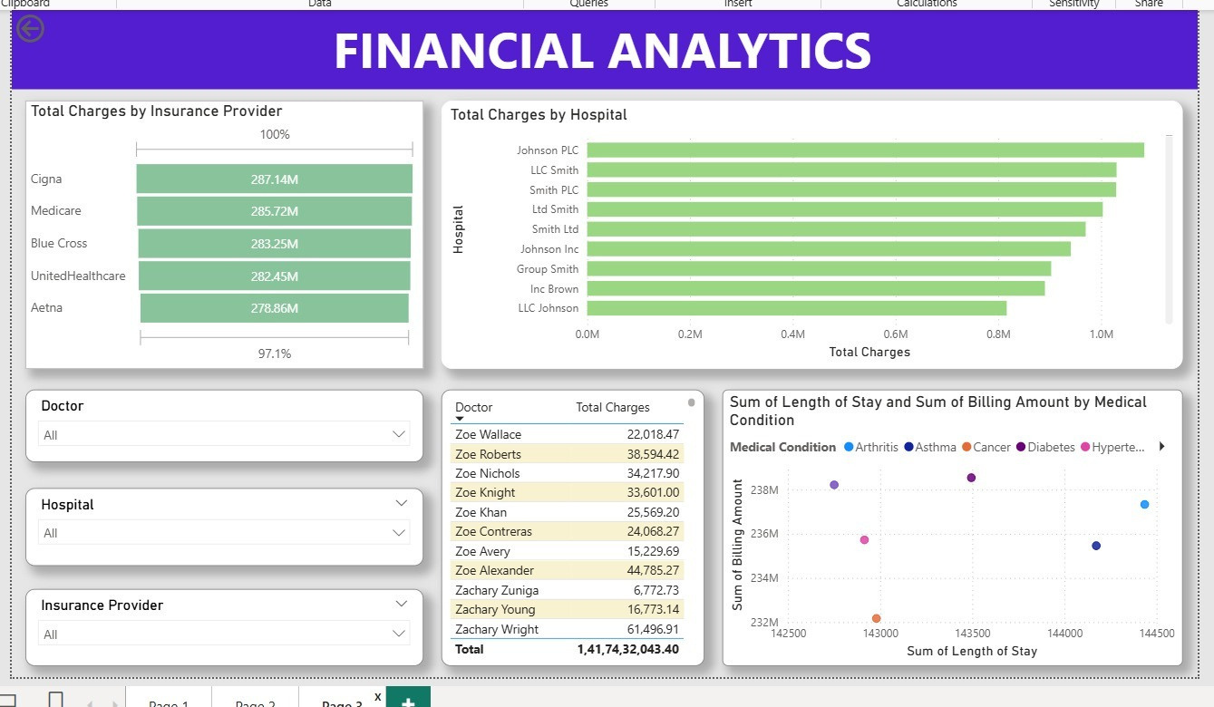

Slide 14





















Financial Analytics
This page analyzes financial performance.
Key visualizations:
• Total charges by insurance provider • Charges by hospital • Doctor-wise billing table • Scatter chart for stay vs billing amount
This helps management understand:
Revenue sources Insurance contribution Hospital performance

Slide 15




Key Insights
Important insightsdiscoveredfromthedashboard:
• Total patients analyzed: 56,000+ • Total healthcare charges: 1.42 Billion • Average patient age: 51 years • Average hospital stay: 15.5 days
Medical findings:
Diabetes and hypertension are common conditions Some conditions require longer hospital stays
Financial findings:
Insurance providers contribute major revenue Some hospitals generate higher charges

Slide 16

Conclusion
This project demonstrateshowPowerBIcantransformraw healthcare data into meaningful insights.
Benefits of the dashboard:
✔ Better healthcare analysis
✔ Faster decision making
✔ Easy visualization of complex data
✔ Interactive exploration using filters
This dashboard helps hospitals improve patient care, cost management,
and operational efficiency.

Slide 17




Thank You

